Slide 1
Random Forest & Boosting

Slide 2

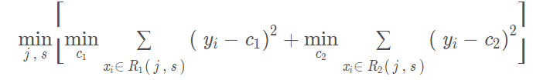
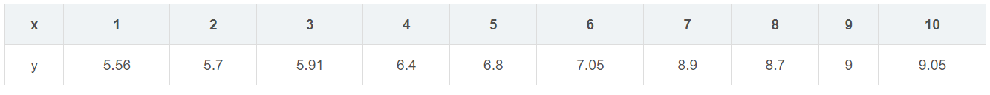
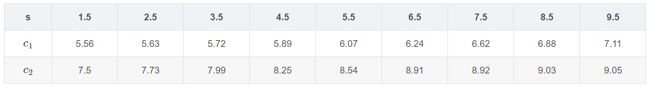
1. Regression Tree Example

Slide 3
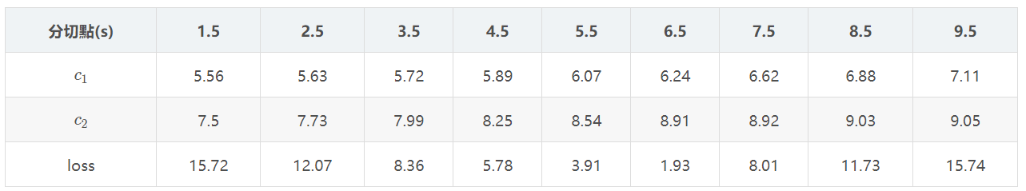
1. Regression Tree Example

Slide 4
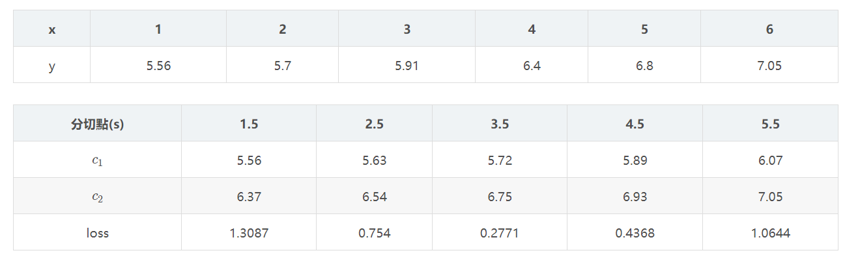
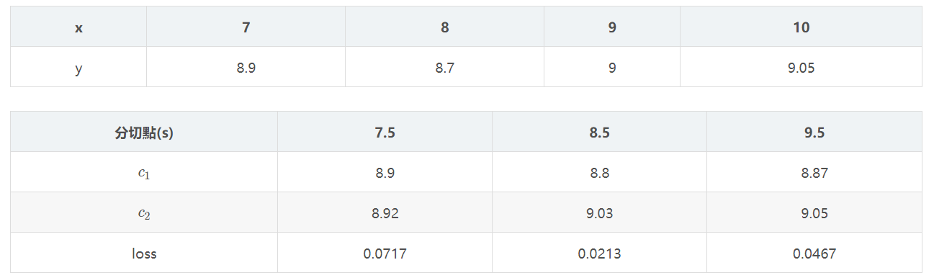
1. Regression Tree Example
R1
R2

Slide 5
2. Random Forest & Boosting
Random forest：
Grow many regression trees to randomized versions of the training data, and average them.
Boosting:
Repeatedly grow shallow trees to the residuals, and hence build up an additive model consisting of a sum of trees.

Slide 6
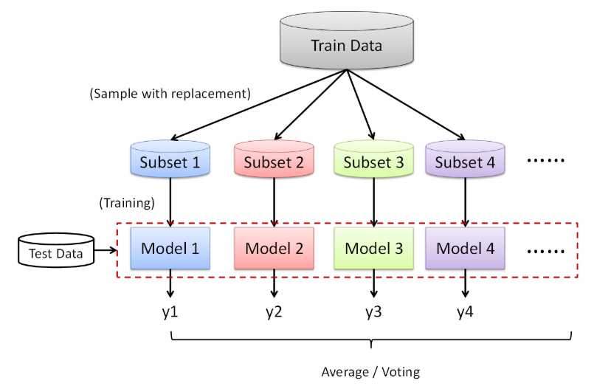

Slide 7
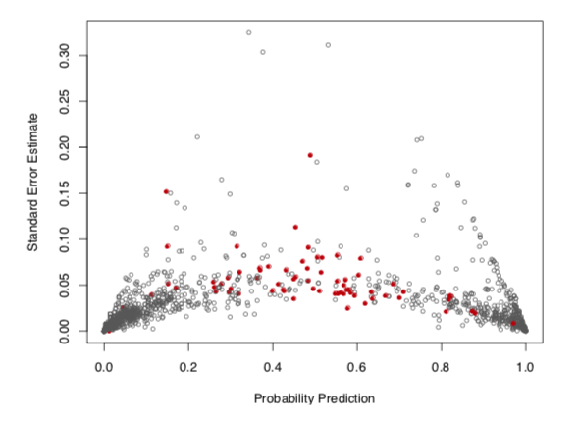
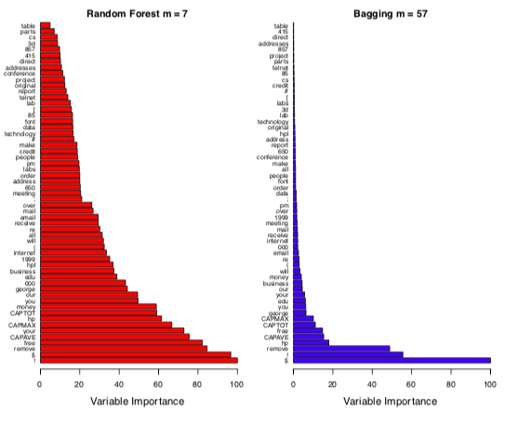

Slide 8
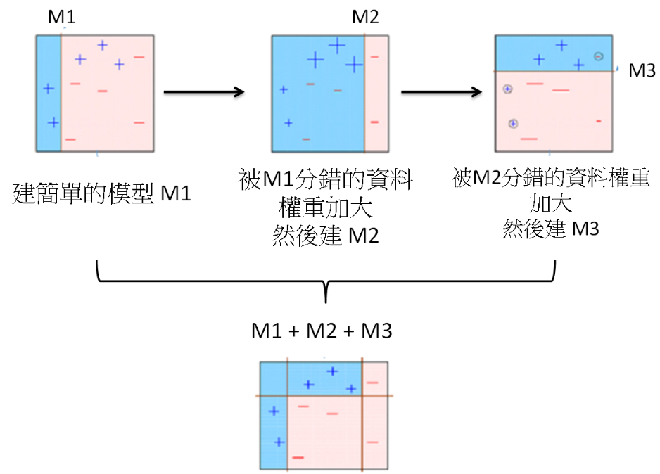

Slide 9

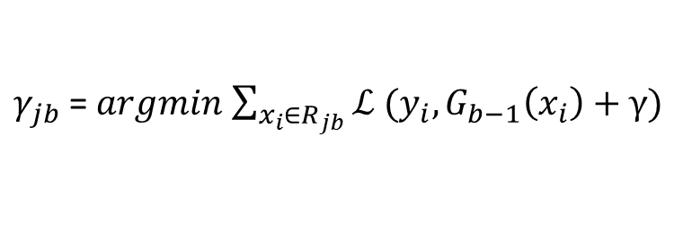
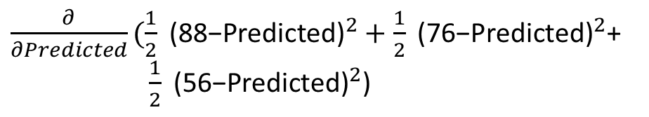

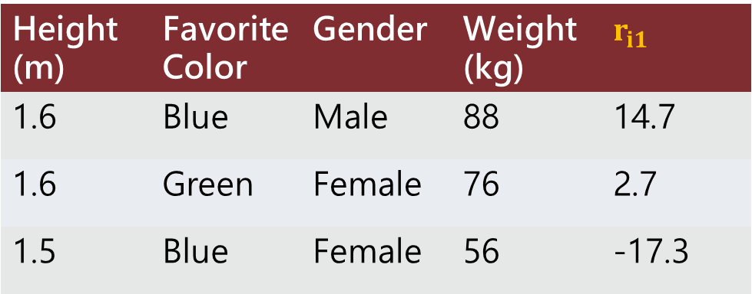
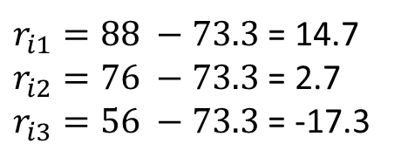
$γ_{jb}$= $argmin$ $\sum_{x_{i}∈R_{jb}}{ℒ (y_{i},G_{b−1}\left(x_{i}\right)+γ)}$
Height (m) | Favorite Color | Gender | Weight (kg)
1.6 | Blue | Male | 88
1.6 | Green | Female | 76
1.5 | Blue | Female | 56
${\frac{∂}{∂Predicted}(\frac{1}{2}\text{ (88−}\text{Predicted}\text{)}}^{2}+{\frac{1}{2}\text{ (}\text{76}\text{−}\text{Predicted}\text{)}}^{2}$+
${\frac{1}{2}\text{ (}\text{56}\text{−}\text{Predicted}\text{)}}^{2}$)
$G_{0}(x)$ = $\frac{88+76+56}{3}$ = 73.3
Fit the regression tree to the $r_{jb}$ values and create terminal regions $R_{jb}$, for j = 1… $J_{m}$
Height (m) | Favorite Color | Gender | Weight (kg) | $$r_{i1}$$
1.6 | Blue | Male | 88 | 14.7
1.6 | Green | Female | 76 | 2.7
1.5 | Blue | Female | 56 | -17.3
$r_{i1}=88 −73.3$ = 14.7
$r_{i2}=76 −73.3$ = 2.7
$r_{i3}=56 −73.3$ = -17.3

Slide 10

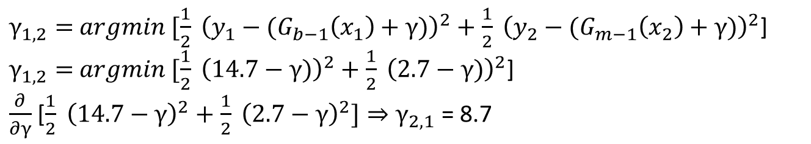
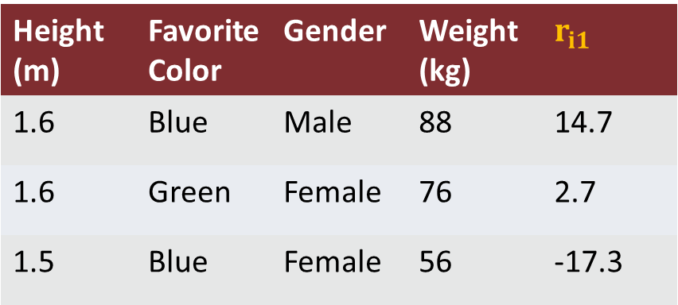
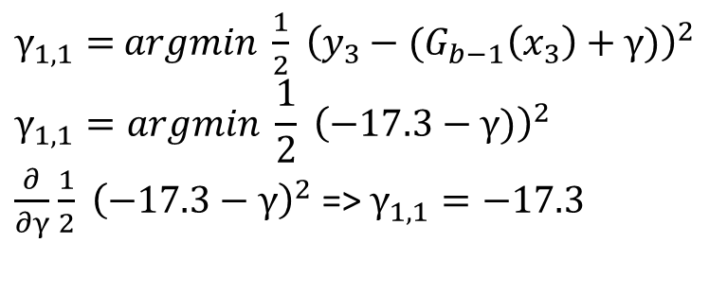
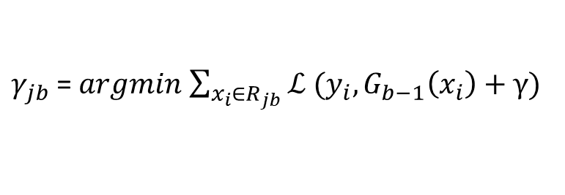

Height < 1.55
Height (m) | Favorite Color | Gender | Weight (kg) | $$r_{i1}$$
1.6 | Blue | Male | 88 | 14.7
1.6 | Green | Female | 76 | 2.7
1.5 | Blue | Female | 56 | -17.3
-17.3
14.7, 2.7
$$R_{1,1}$$
$$R_{2,1}$$
$γ_{jb}$= $argmin$ $\sum_{x_{i}∈R_{jb}}{ℒ (y_{i},G_{b−1}\left(x_{i}\right)+γ)}$
$γ_{1,2}=$ $argmin [\frac{1}{2} {\left(y_{1}−{(G}_{b−1}\left(x_{1}\right)+γ)\right)}^{2}+\frac{1}{2} {\left(y_{2}−{(G}_{m−1}\left(x_{2}\right)+γ)\right)}^{2}$]
$γ_{1,2}=$ $argmin [\frac{1}{2} {\left(14.7−γ)\right)}^{2}+\frac{1}{2} {\left(2.7−γ)\right)}^{2}$]
$\frac{∂}{∂γ}$ [$\frac{1}{2} {\left(14.7−γ\right)}^{2}+\frac{1}{2} {\left(2.7−γ\right)}^{2}]⇒γ_{2,1}$ = 8.7
$γ_{1,1}=$ $argmin \frac{1}{2} {\left(y_{3}−{(G}_{b−1}\left(x_{3}\right)+γ)\right)}^{2}$
$$γ_{1,1}=argmin \frac{1}{2} {\left(−17.3−γ)\right)}^{2}$$
$\frac{∂}{∂γ}$ $\frac{1}{2} {\left(−17.3−γ\right)}^{2}$ => $γ_{1,1}=−17.3$

Slide 11










Height < 1.55
Height < 1.55
$G_{0}(x)$
0.1
$G_{1}(x)$ = 73.3 +
$ε$ x
-17.3
14.7, 2.7
-17.3
14.7, 2.7
$$R_{1,1}$$
$$R_{2,1}$$
Update $G_{b}(x)$= $G_{b−1}\left(x\right)$ + $g_{b}$, $g_{b}$ = $ε$ x $\hat{g_{b}}$
$$R_{1,1}$$
$$R_{2,1}$$
$$γ_{1,1}=−17.3$$
$γ_{2,1}$ = 8.7
$$γ_{1,1}=−17.3$$
$γ_{2,1}$ = 8.7
Height (m) | Favorite Color | Gender | Weight (kg)
1.6 | Blue | Male | 88
1.6 | Green | Female | 76
1.5 | Blue | Female | 56
Height (m) | Favorite Color | Gender | Weight (kg) | New Prediction
1.6 | Blue | Male | 88 | 74.2
1.6 | Green | Female | 76 | 74.2
1.5 | Blue | Female | 56 | 71.6

Slide 12







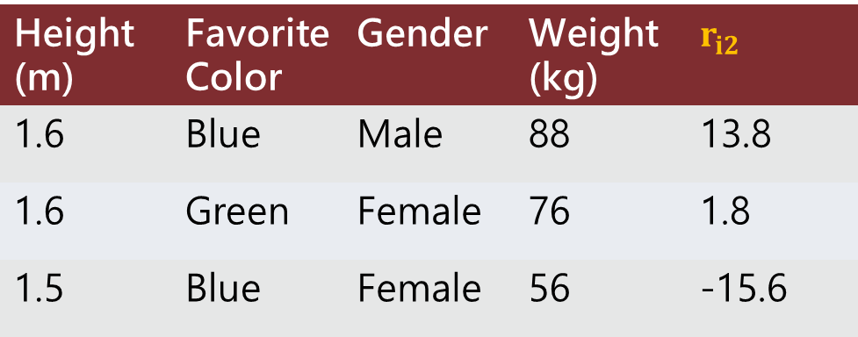



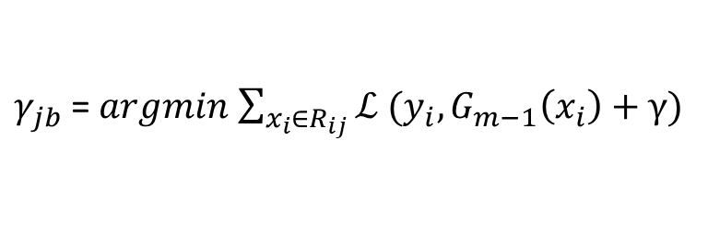






$γ_{jb}$= $argmin$ $\sum_{x_{i}∈R_{ij}}{ℒ (y_{i},G_{m−1}\left(x_{i}\right)+γ)}$
Height (m) | Favorite Color | Gender | Weight (kg) | $$r_{i2}$$
1.6 | Blue | Male | 88 | 13.8
1.6 | Green | Female | 76 | 1.8
1.5 | Blue | Female | 56 | -15.6
Height < 1.55
-15.6
13.8, 1.8
$$R_{1,2}$$
$$R_{2,2}$$
$$γ_{1,2}=−15.6$$
$$γ_{2,2}=7.8$$
Height < 1.55
Height < 1.55
$G_{0}(x)$
$G_{2}(x)$ = 73.3 +
$0.1$ x
$+ 0.1$ x
-17.3
14.7, 2.7
-15.6
13.8, 1.8
$$R_{1,1}$$
$$R_{2,1}$$
$$R_{1,2}$$
$$R_{2,2}$$
$$γ_{1,1}=−17.3$$
$γ_{2,1}$ = 8.7
$$γ_{1,2}=−15.6$$
$$γ_{2,2}=7.8$$

Slide 13












Height (m) | Favorite Color | Gender | Weight (kg)
1.4 | Green | Male | ???
Predicted Weight = 73.3 + $(0.1$x -17.3$)+ ($0.1 x -15.6$)$ = 70
Height < 1.55
Height < 1.55
$G_{0}(x)$
$G_{2}(x)$ = 73.3 +
$0.1$ x
$+ 0.1$ x
-17.3
14.7, 2.7
-15.6
13.8, 1.8
$$R_{1,1}$$
$$R_{2,1}$$
$$R_{1,2}$$
$$R_{2,2}$$
$$γ_{1,1}=−17.3$$
$γ_{2,1}$ = 8.7
$$γ_{1,2}=−15.6$$
$$γ_{2,2}=7.8$$

Slide 14
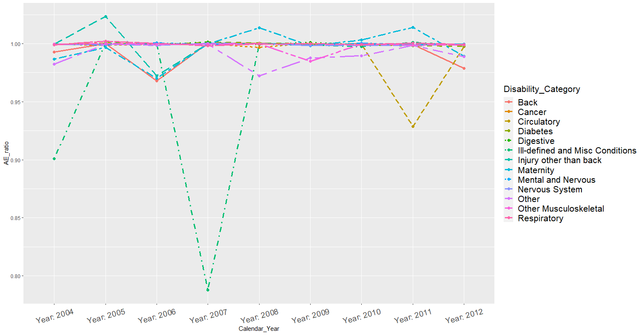
3. Results from Random Forests

Slide 15
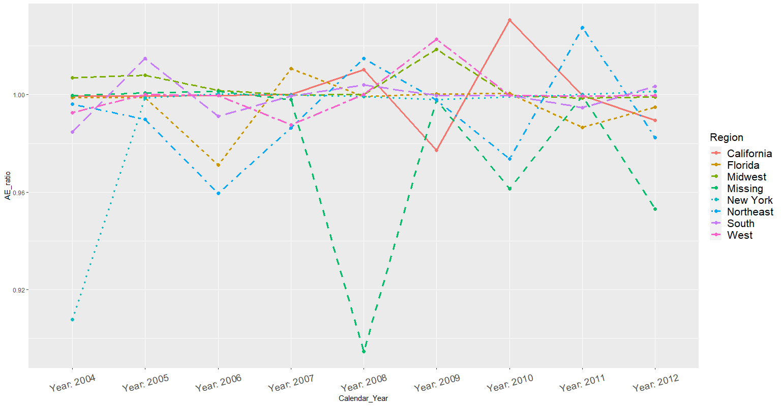
3. Results from Random Forests

Slide 16
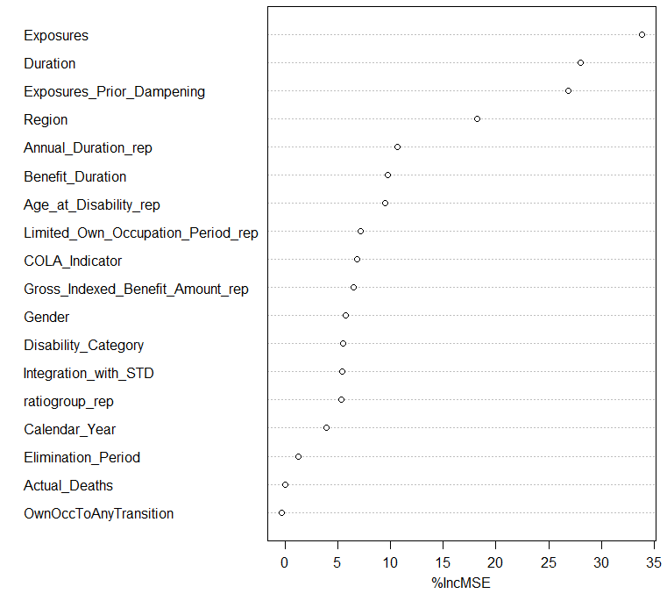
3. Results from Random Forests

Slide 17
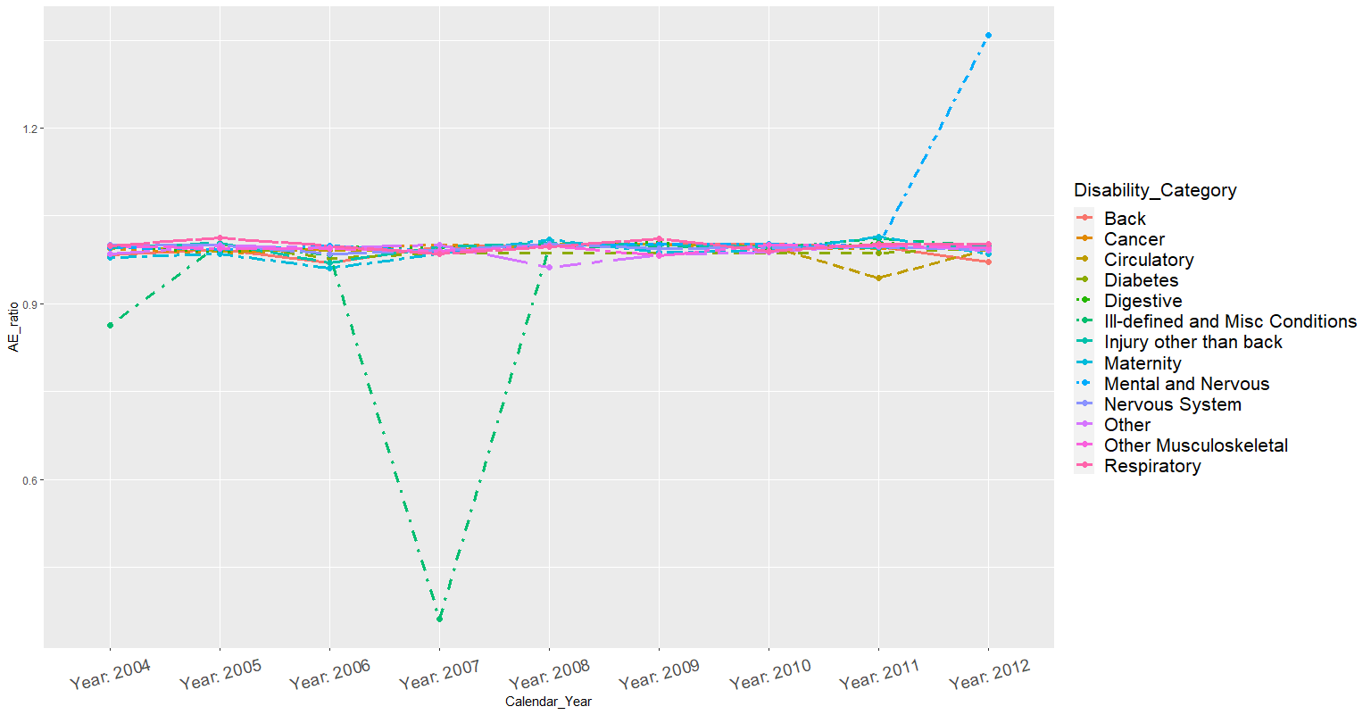
3. Results from Gradient Boosting

Slide 18
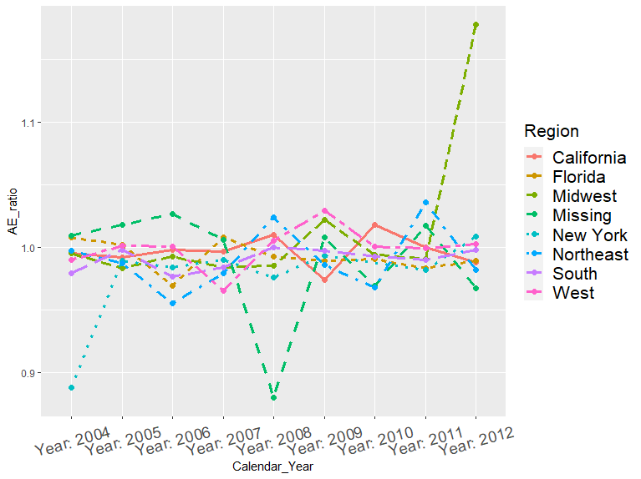
3. Results from Gradient Boosting

Slide 19
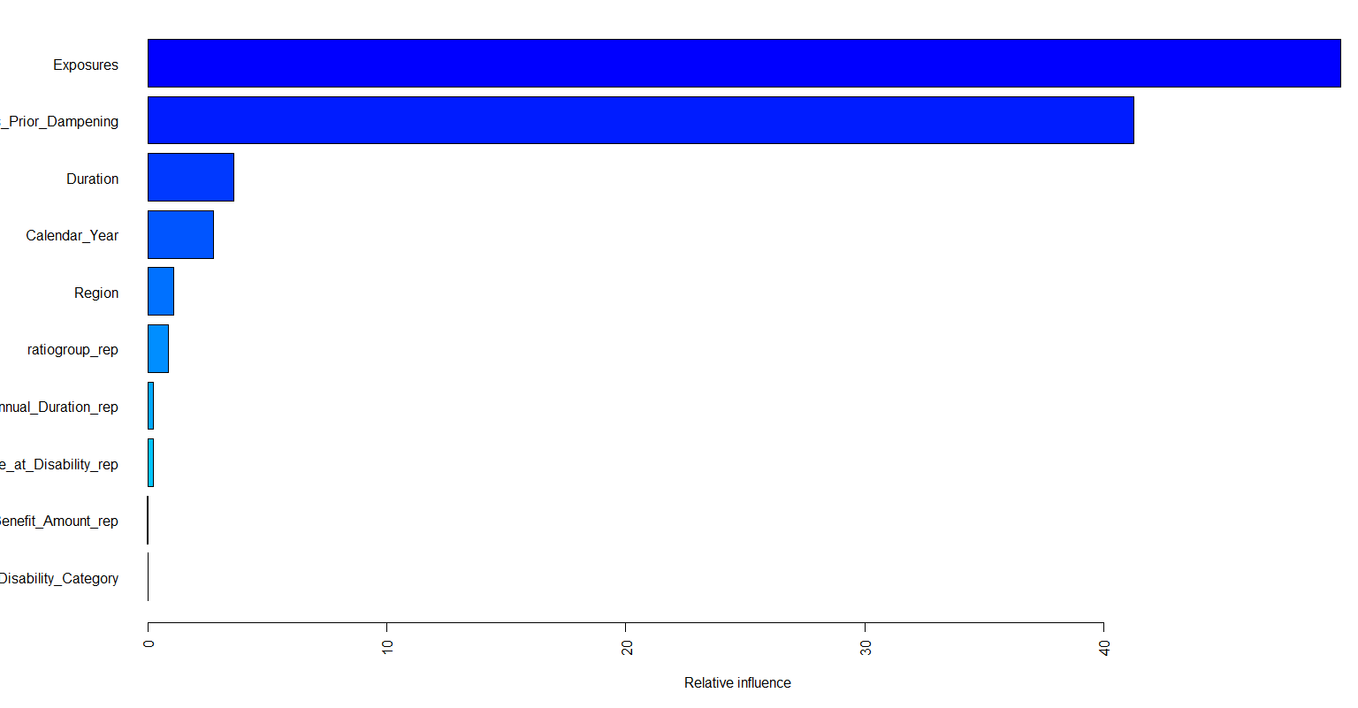
3. Results from Gradient Boosting

Slide 20
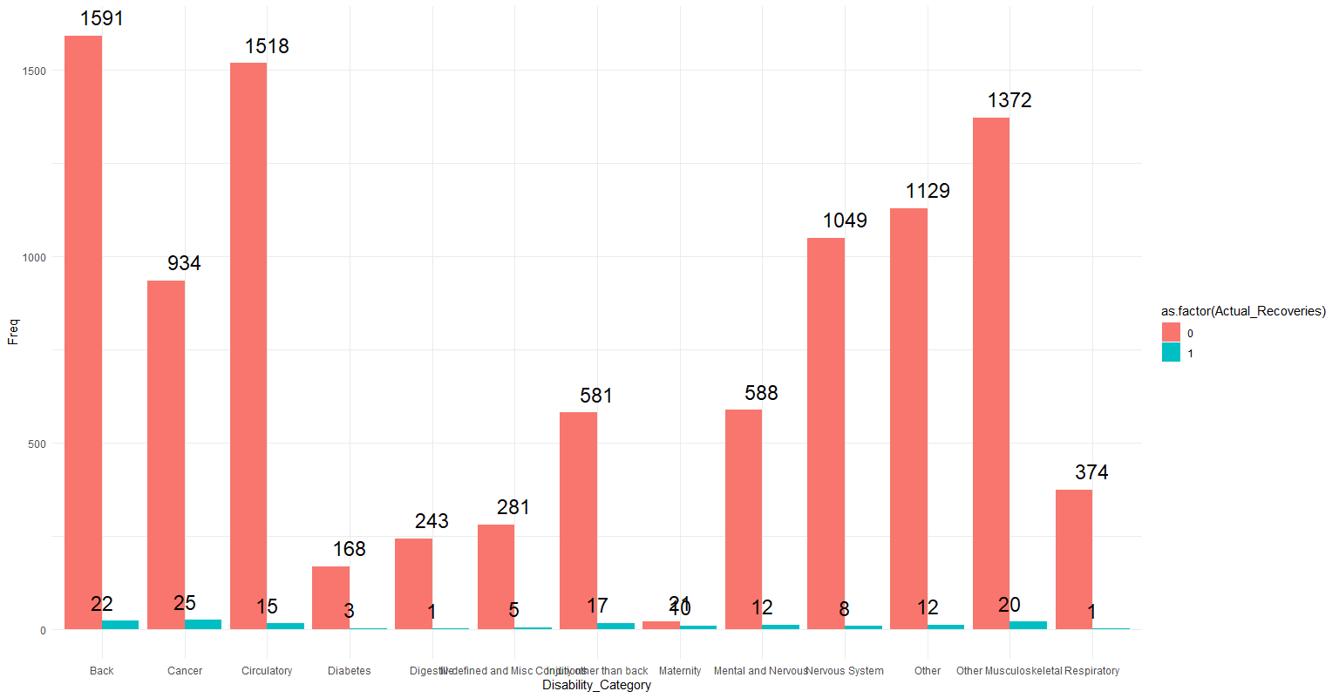
Group 3 DataSet Analysis

Slide 21
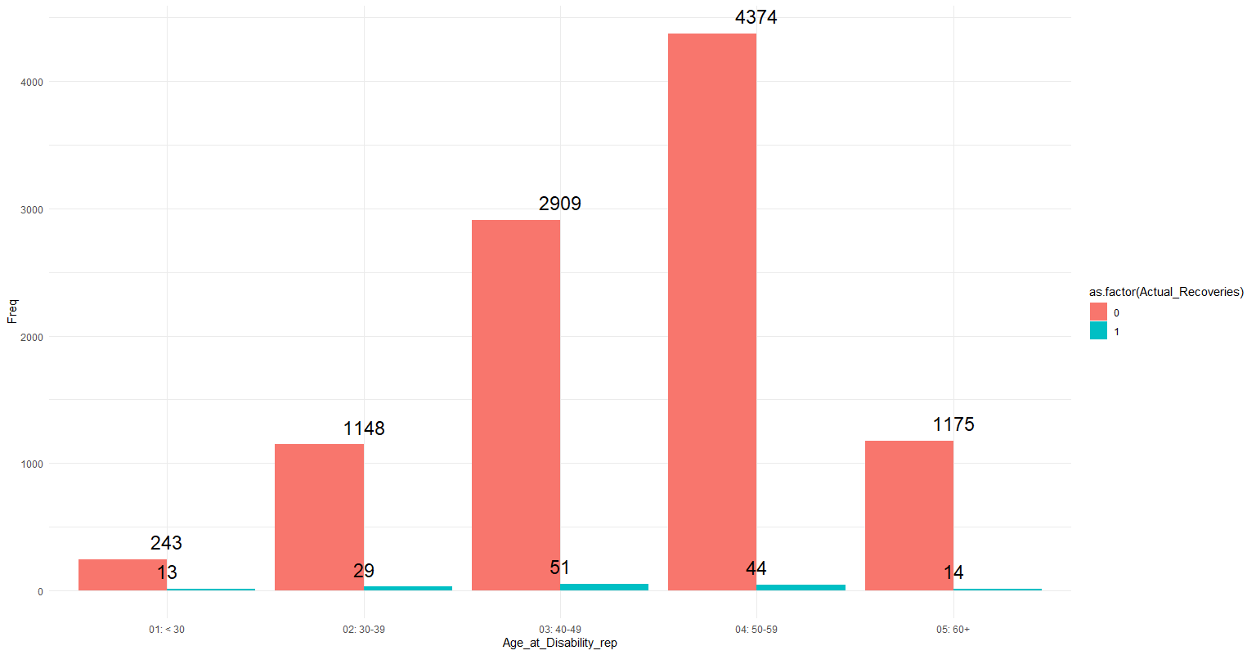
Group 3 DataSet Analysis

Slide 22
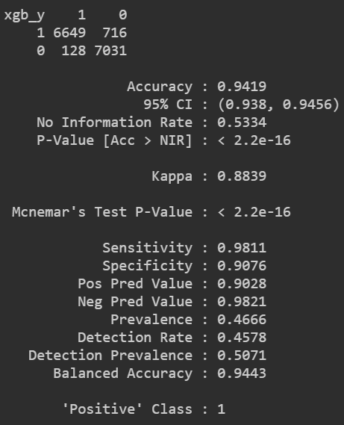
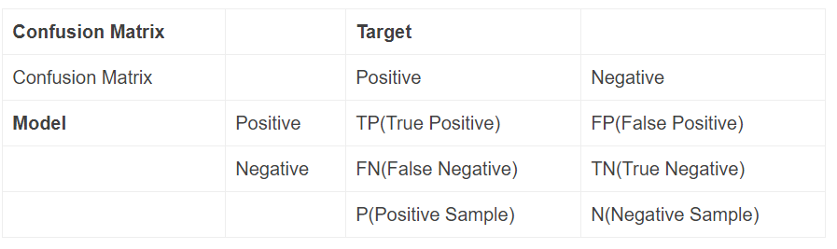
Model Predict Indicators (Confusion Matrix)
Sensitivity：True Positive Rate (TPR)
Specificity : True negative rate (TNR)
Balanced Accuracy = (Sensitivity+Specificity)/2

Slide 23
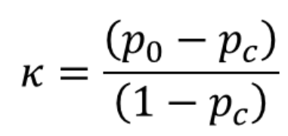

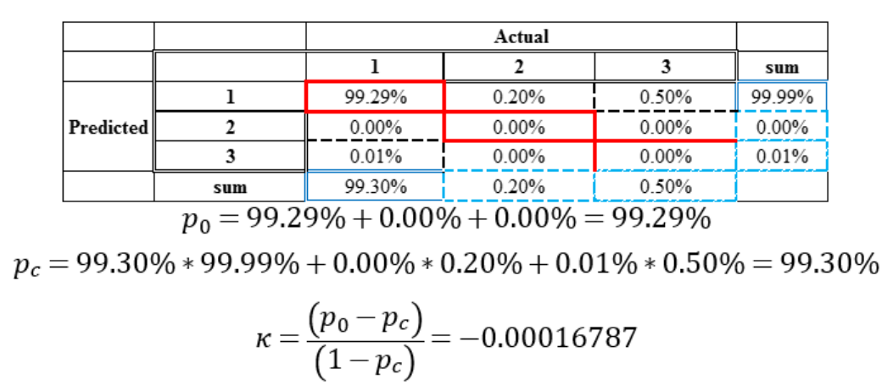
Model Predict Indicators (Kappa)

